Slide 1

Home
NORTH AMERICA RETAIL SUPPLY CHAIN AND SALES ANALYSIS
General
Detalle

Slide 2



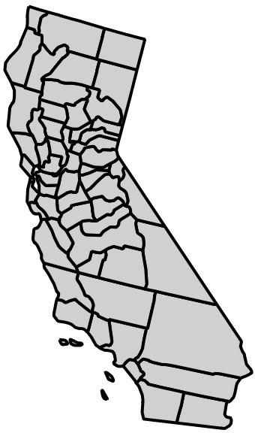
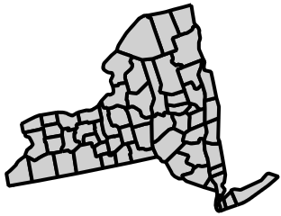
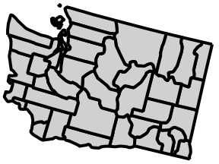
NORTH AMERICA RETAIL SUPPLY CHAIN AND SALES ANALYSIS
Home
Top 3 Estados gestión suministros
California
General
Detalle
New York
Washington

Slide 3
NORTH AMERICA RETAIL SUPPLY CHAIN AND SALES ANALYSIS
Home
General
Detalle

